Slide 1
WELCOME PAGE
YUVAL
SHARON
NAOMI

Slide 2
What is FRT and CERT?
FRT – First Response Team: Trained individuals who provide immediate assistance during emergency situations. The first line of defense, delivering urgent aid and coordination until additional support arrives
CERT – Community Emergency Response Teams: Residents of the community and active volunteers, who have undergone basic training, form a response and support team for emergencies and crises. The CERT program teaches basic skills like fire safety, light rescue, first aid, and volunteer management. CERT members provide immediate support in these areas until responders arrive, enhancing a community's resilience and response capabilities in crises.

Slide 3
What is FRT?
First Response Team (FRT)
Frontline armed responders providing immediate action during crises.
Rapid deployment to emergency scenes.
Provides urgent aid and coordination.
Activities Include: patrolling and gatekeeping to ensure area security
Notes:
Both teams work both in emergency and during regular routine

Slide 4
What is CERT?
Community Emergency Response Teams (CERT)
Community volunteers trained for initial crisis response.
Enhances community resilience and emergency preparedness.
Typically organized into Health, Education, Logistics, and Spokesperson teams
Activities Include: Responding to injuries, organizing educational events, and managing logistics during emergencies.
Notes:
Both teams work both in emergency and during regular routine

Slide 5
First Response Team
Group of trained individuals, including professionals and volunteers, who provide immediate assistance during emergency situations. They act as the first line of defense, delivering urgent aid and coordination until additional support arrives

Slide 6
Community Emergency Response Teams
Trained civilian volunteers who assist professional responders during emergencies across sectors like health, education, and logistics. The CERT program teaches basic skills like fire safety, light rescue, first aid, and volunteer management. CERT members provide immediate support in these areas until responders arrive, enhancing a community's resilience and response capabilities in crises.

Slide 7
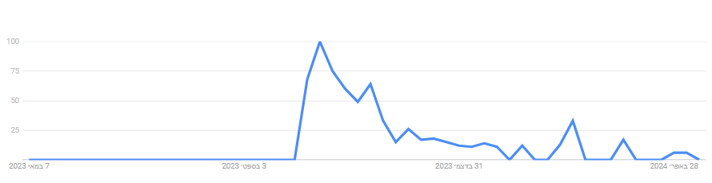
The Urgent Need for Rapid First Response
In emergencies, the army and other traditional systems like police and fire services often face delays, which can be critical. Rapid first response is essential in cases such as:
Terror Attacks: Seconds count in securing areas and providing care.
Natural Disasters: Such as earthquakes and floods, where immediate action can save lives.
Urban Incidents: Managing fires and major traffic accidents to prevent escalation.
The graph displays the search interest for "כיתת כוננות" over the past year Google Trends

Slide 8
The Problem
Effective emergency management systems are crucial, yet existing tools and processes often fall short, leading to communication breakdowns, delays, and inefficiencies that can have devastating consequences.

Slide 9
Current tools
We conducted research on tools designed to enhance the capabilities of the teams.
Avuka Squad: System suite was designed and developed to supply a comprehensive location based C2 (Command and Control) solution for organizations with complex security needs.
AVIA: System operates as an emergency population management system that enables control over complex security and civilian events.
Zello: Modern and customizable walkie-talkie app (and more) that lives on any smart device.
Whatsapp:
The existing tools provide some features for first response teams, but lack a comprehensive, integrated solution that meets all their diverse needs.

Slide 10
Current tools
We conducted research on tools designed to enhance the capabilities of the teams.
The existing tools provide some features for first response teams, but lack a comprehensive, integrated solution that meets all their diverse needs.

Slide 12
Interviews
We visited the Golan settlements to better understand the needs of teams in high-risk areas.
Interview Summaries:
Muli Shpigel: Emphasizes the need for a system that connects operational teams effectively and facilitates communication.
Roee Tavor: Highlights the necessity for technology that functions without GPS and internet, especially after disruptions.
Hagit Geva & Itamar Cohen: Stress the importance of user-friendly tech with role-specific functionalities and the ability to mark significant locations for task management.
Maybe add the quotes ???

Slide 13


Interviews
Emphasized the need for a system that connects operational teams effectively and facilitates communication.
“During the events of 07.10.2023, effective communication between the settlement FRTs could save lives.”
Muli Shpigel Architect, Director of Engineering and Planning Department, the settlements in the Golan
Highlighted the necessity for simple UI and a technology that functions without GPS. Roee also mentioned that they don’t want to replace their existing Walkie Talkies.
“Since the blackout on 7.10, we've realized the necessity for technology that works independently of GPS connection”
Roee Tavor
Head of CERT in Kanaf settlement
Highlighted the importance of user-friendly tech with role-specific functionalities for efficient task management, and the necessity of a strict hierarchy with appropriate permissions.
“It's crucial our tools are intuitive. during a crisis, no one should struggle with complex interfaces.”
Hagit Geva, Itamar Cohen
Head of & Deputy Head of the CERT in Givat Yoav settlement.

Slide 14
Our solution
Our solution is to develop an advanced web and mobile application tailored for first and community emergency response teams. This application is designed to optimize communication and operational efficiency, especially in high-risk and recently impacted areas. We are committed to delivering the best possible user interface and accessibility, ensuring that our application is user-friendly and inclusive for all users.

Slide 15
Our solution
Advanced Web and Mobile Application for Emergency Response Teams
Optimized Communication: Tailored to enhance coordination among first and community emergency response teams, especially in high-risk and recently impacted areas.
Operational Efficiency: Streamlines processes to improve response times and effectiveness, with a complex web application for deep logic operations and a simpler, intuitive mobile app for on-the-go accessibility.
Exceptional User Interface and Accessibility: Committed to delivering a user-friendly experience that is accessible and inclusive for all users, ensuring efficient operation across devices.
Comprehensive Feature Set:
Task Management: Enables assigning, tracking, and updating tasks efficiently.
Interactive Map: Provides real-time geographical data for strategic planning and response.
Roles and Permissions: Ensures information security by assigning specific capabilities and access based on user roles.
Adaptable Views: Allows entities like Regional Councils to monitor activities across different settlements.
Message Board: Facilitates effective communication and information sharing among team members.
Reports Page: Archives and allows easy retrieval of past reports for review and analysis.
Alarm and Event Systems: Enhances response capabilities with customizable alerts and a structured event management framework.

Slide 16
Our solution
Advanced Web and Mobile Application for Emergency Response Teams
Optimized Communication: Tailored to enhance coordination among first and community emergency response teams, especially in high-risk and recently impacted areas.
Operational Efficiency: Streamlines processes to improve response times and effectiveness, with a complex web application for deep logic operations and a simpler, intuitive mobile app for on-the-go accessibility.
Exceptional User Interface and Accessibility: Committed to delivering a user-friendly experience that is accessible and inclusive for all users, ensuring efficient operation across devices.
Comprehensive Feature Set:
Task Management: Enables assigning, tracking, and updating tasks efficiently.
Interactive Map: Provides real-time geographical data for strategic planning and response.
Roles and Permissions: Ensures information security by assigning specific capabilities and access based on user roles.
Adaptable Views: Allows entities like Regional Councils to monitor activities across different settlements.
Message Board: Facilitates effective communication and information sharing among team members.
Reports Page: Archives and allows easy retrieval of past reports for review and analysis.
Alarm and Event Systems: Enhances response capabilities with customizable alerts and a structured event management framework.

Slide 17
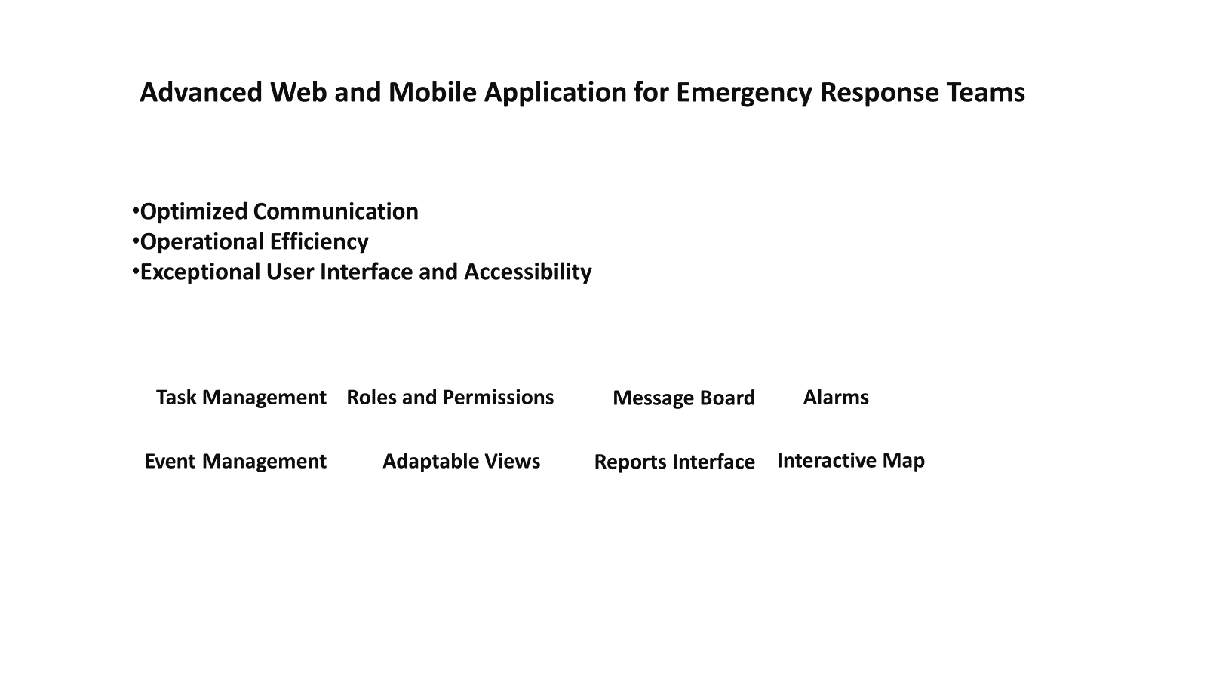

Slide 18
Main Functional Requirements
ID | Requirement
1 | Users system: Login & register
2 | Groups: Create and Join a group
3 | Alerts: Starting an alarm
4 | Communication: Start a chat and see events history
5 | Map: Interactive map with location, marking and sectoring functionality
6 | Tasks: Create and assign a task

Slide 19
Main Non Functional Requirements
ID | Requirement
1 | Three-nines availability (99.9%) - no more than ~9 hours downtime per year
2 | Encrypting all chats and not saving PII (Personal Identifiable Information)
3 | Maps: One of: Google Maps, Leaflet, Mapbox, OpenLayers
4 | Handle up to 10,000 users simultaneously without performance degradation
5
6

Slide 20
Diagram

Slide 21
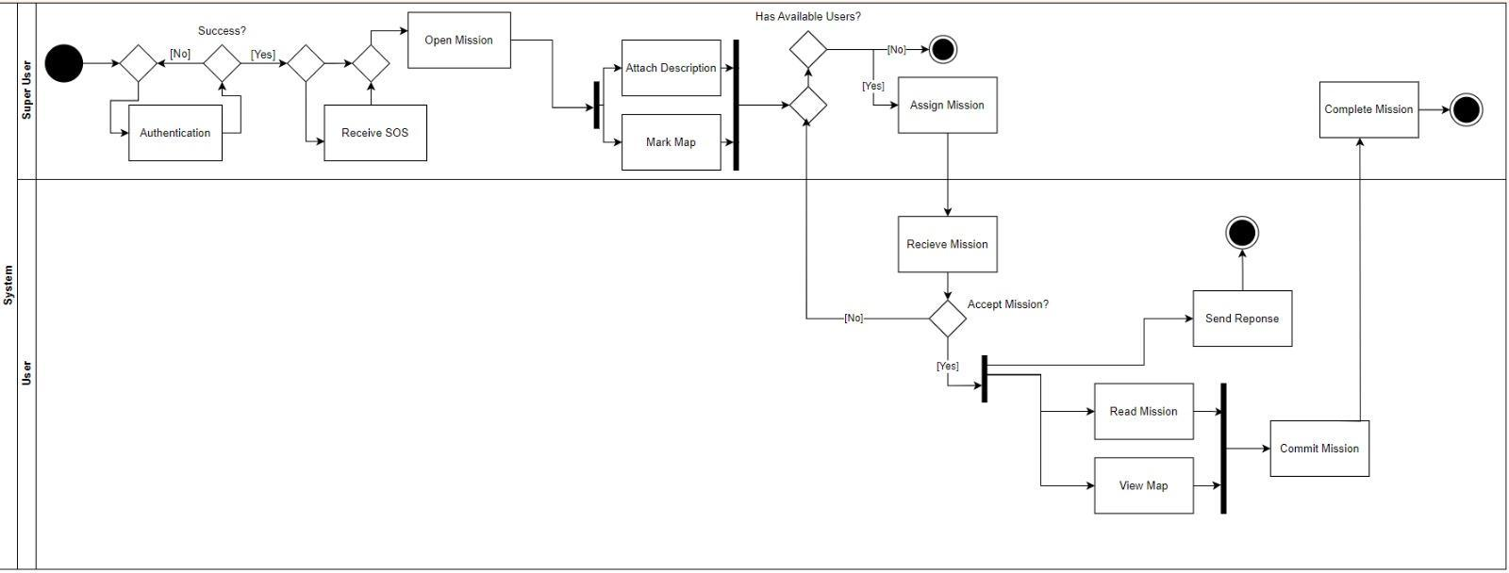
Activity Diagram

Slide 22
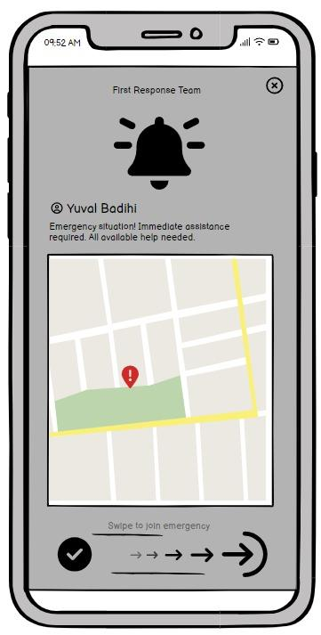
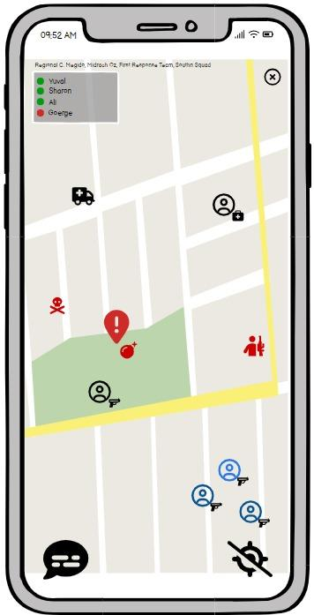
Screens

Slide 23
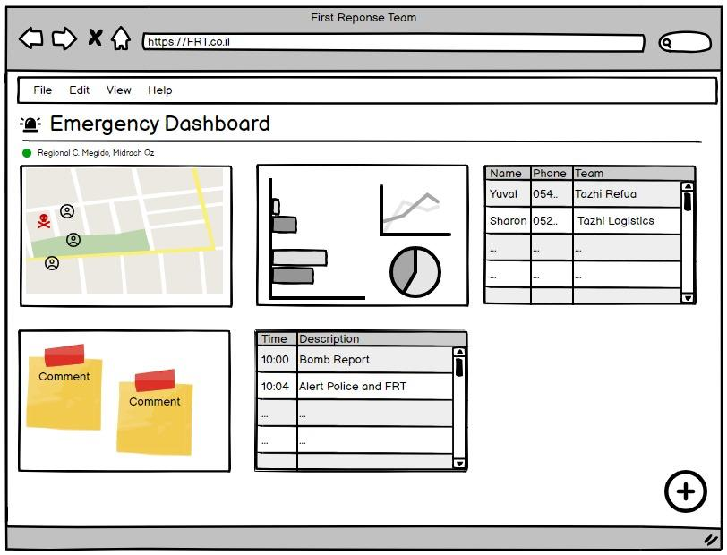
Screens

Slide 24
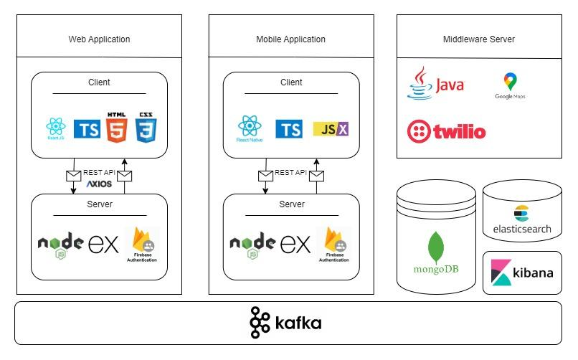
Technologies

Slide 25
6.Expected Achievements
Enhanced Coordination: The application will facilitate real-time coordination among different teams, improving response efficiency during emergencies.
Reliable Functionality Offline: Key features will be accessible without constant internet connectivity, ensuring functionality under varied conditions.
Dynamic Role-Based Access: Customizable interfaces and functionalities based on user roles and permissions, ensuring that each team member has the tools and information necessary for their responsibilities.
Mapping and Task Management: Features for marking significant locations and assigning tasks, enhancing operational awareness and efficiency.
User-Friendly Design: A focus on intuitive navigation and accessibility to encourage adoption and minimize training requirements.

Slide 26

How we plan on measuring our success
We plan to maintain close relationships with users, gathering their feedback during development and post-launch to enhance our offerings.
BI Events - Key activities within our system where data is collected and analyzed to improve decision-making
SUS (System Usability Scale) - A tool to evaluate the usability of our product through standardized questionnaires.
CSAT (Customer Satisfaction Score) - A metric assessing customer satisfaction with our product or service through quick surveys

Slide 27
Challenges
Data Synchronization: Ensuring seamless sync across devices in fluctuating network conditions.
Interface Simplicity vs. Feature Richness: Balancing a simple user interface with the complex functionalities needed by different teams.
Scalability: Preparing the system to handle increasing amounts of data and users without performance loss.
Tech: React Native - new to us, Deployment to both IOS and Android

Slide 28
TY!

